Slide 1



Noida Institute of Engineering and Technology, Greater Noida
Linked List
UNIT-3
Unit: 3
Data Structures
Dr. Ritesh Rastogi
Associate Professor
Dept. of CSE, M.Tech(Integrated)
(B Tech 3rd Sem)

Slide 2

Faculty Profile
Dr. Ritesh Rastogi (M.Tech,, Ph.D)
(Associate Professor, Dept. of IT, M.Tech (CSE) Integrated
NIET, Greater Noida
Experience : 25 Years (Teaching and Research)
Area of Interest : Software Engg./Testing ,DBMS, Cloud
Honors , Awards and Achievements
Published more than 50 papers in SCI/Scopus/peer reviewed national/international journals and conferences
Authored four books of computer science and a book chapter.
Published and Granted 04 Patents
Guided around 120 PG thesis and projects of M.Tech and MCA Students
Awarded as “Corona Warrior” by Engineering and Management College Teachers Development Association
Research Excellence Award 2020 from Institute of Scholars for research work.
Best Research Paper Award, in ICFCCT 2021 organized by IFERP on 27-28th Oct 2021 Mumbai
Humanitarian Excellence Awards 2021, Certificate of Appreciation by I Can Foundation
Member of professional societies like ISTE, IFERP, C# Corner, Oracle Incorp. IAENG, InSc.
Brand ambassador of IFERP. And Coordinator for IIRS-ISRO Dehra dun.
Member of Editorial board of International Journal.
Dr. Ritesh Rastogi

Slide 3


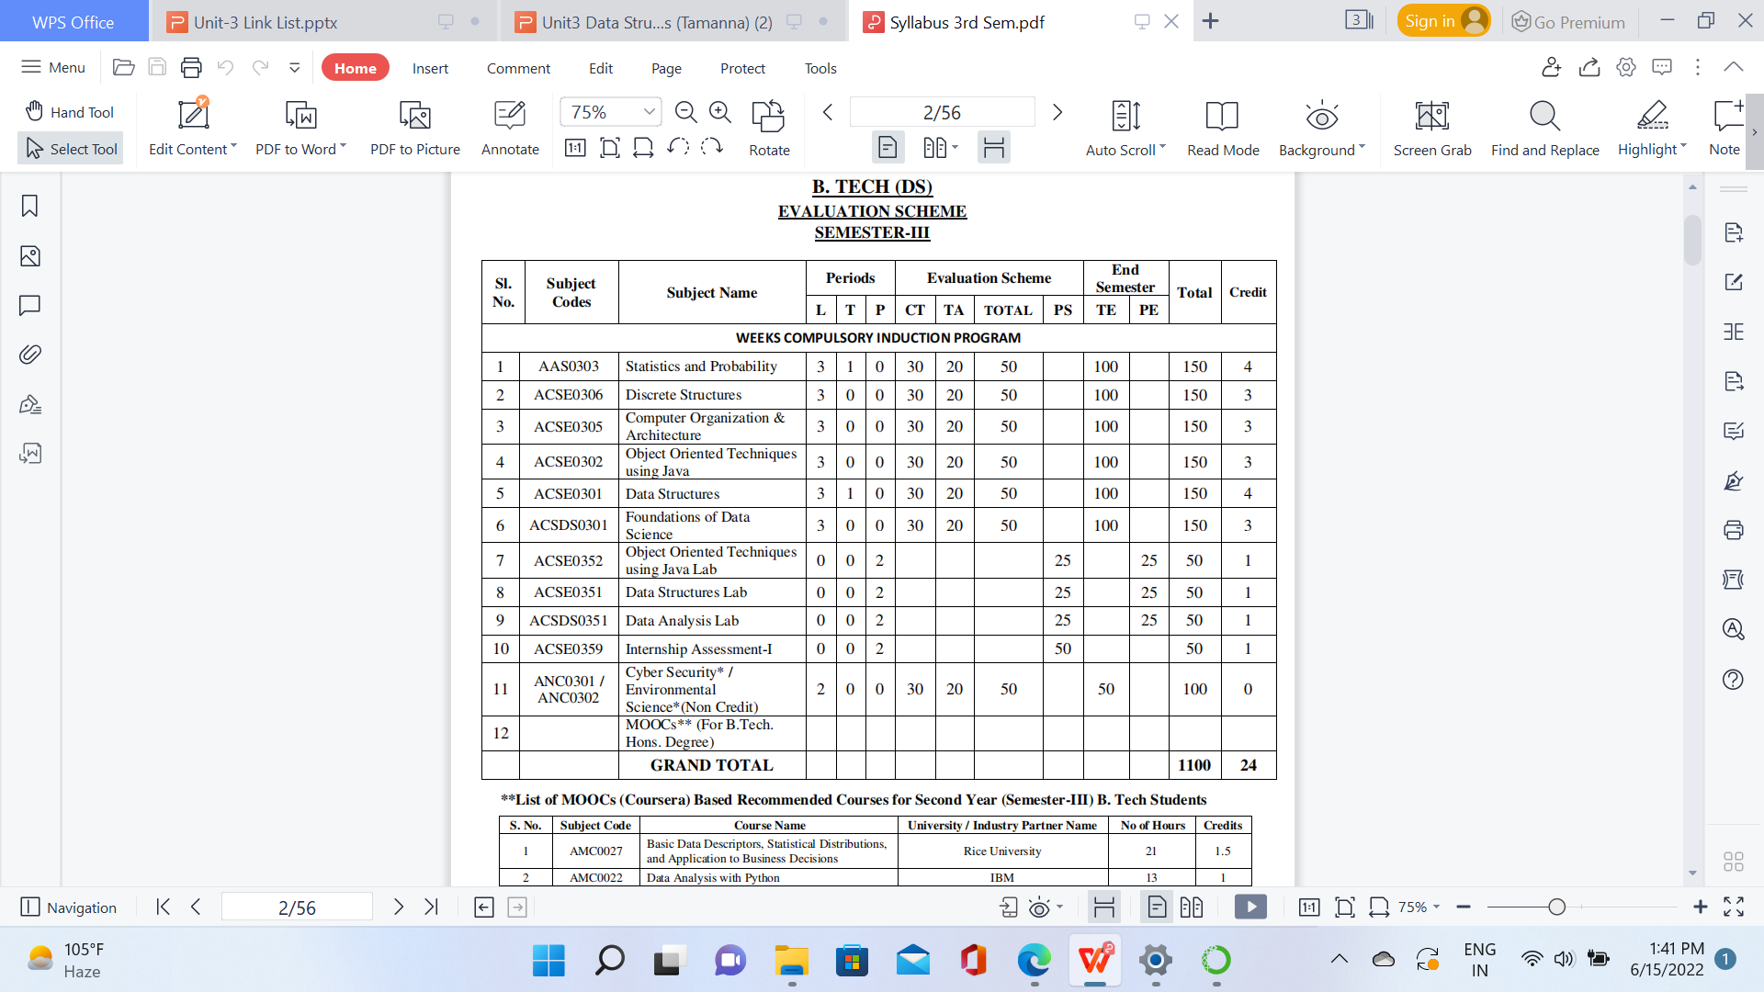
Evaluation Scheme

Slide 4

Unit III Syllabus
Advantages of linked list over array,
Self-referential structure,
Singly Linked List, Doubly Linked List, Circular Linked List.
Operations on a Linked List: Insertion, Deletion, Traversal, Reversal, Searching, Polynomial Representation and Addition of Polynomials.
Implementation of Stack and Queue using Linked lists.

Slide 5
Unit Content
Advantages of Linked List over Array
Singly Linked List
Doubly Linked List
Circular Linked List
Operation on Linked List
Insertion
Deletion
Traversal
Reversal
Searching Polynomial Representation
Addition, Subtraction and Multiplication of Polynomials
Implementation of Stack and Queue using Linked List

Slide 6
Unit Objective
To learn about linked lists.
To understand different types of Linked list.
Basic operations of linked list.

Slide 7
Course Objective
Introduction to basic data structures.
To know about the basic properties of different data structures.
Classification and operations on data structure
Understand algorithms and their efficiency
Study logical and mathematical description of array and link list.
Implementation of array and link list on computer.
Differentiate the usage of array and link list in different scenarios.

Slide 8
Course Outcome
CO | CO Description | Bloom’s Knowledge Level (KL)
CO 1 | Describe the need of data structure and algorithms in problem solving and analyze Time space trade-off. | K2, K4
CO 2 | Describe how arrays are represented in memory and how to use them for implementation of matrix operations, searching and sorting along with their computational efficiency. | K2, K6
CO 3 | Design, implement and evaluate the real-world applications using stacks, queues and non-linear data structures. | K5, K6
CO 4 | Compare and contrast the advantages and disadvantages of linked lists over arrays and implement operations on different types of linked list. | K4, K6
CO 5 | Identify and develop the alternative implementations of data structures with respect to its performance to solve a real-world problem. | K1, K3, K5, K6

Slide 9
Program Outcomes (POs)
1. Engineering knowledge
2. Problem analysis
3. Design/development of solutions
4. Conduct investigations of complex problems
5. Modern tool usage
6. The engineer and society
7. Environment and sustainability
8. Ethics
9. Individual and team work
10. Communication
11. Project management and finance
12. Life-long learning

Slide 10
CO-PO Mapping
CO-PO correlation matrix of Data Structure (KCS 301)
 | PO1 | PO2 | PO3 | PO4 | PO5 | PO6 | PO7 | PO8 | PO9 | PO10 | PO11 | PO12
ACSE0301.1 | 3 | 3 | 3 | 2 | - | 1 | - | 1 | 2 | 2 | 2 | 2
ACSE0301.2 | 3 | 3 | 2 | 2 | - | 1 | - | 1 | 2 | 2 | 1 | 2
ACSE0301.3 | 3 | 3 | 2 | 2 | - | 1 | - | 1 | 2 | 2 | 2 | 2
ACSE0301.4 | 3 | 3 | 2 | 2 | - | 1 | - | 1 | 2 | 2 | 2 | 2
ACSE0301.5 | 3 | 3 | 3 | 3 | 2 | 2 | 2 | 2 | 3 | 3 | 3 | 3
Average | 3 | 3 | 2.4 | 2.2 | 0.4 | 1.2 | 0.4 | 1.2 | 2.2 | 2.2 | 2 | 2.2

Slide 11
Program Specific Outcomes (PSOs)
On successful completion of graduation degree the Engineering graduates will be able to:
PSO1: The ability to design and develop the hardware sensor device and related interfacing software system for solving complex engineering problem.
PSO2: The ability to understanding of Inter disciplinary computing techniques and to apply them in the design of advanced computing .
PSO 3: The ability to conduct investigation of complex problem with the help of technical, managerial, leadership qualities, and modern engineering tools provided by industry sponsored laboratories.
PSO 4: The ability to identify, analyze real world problem and design their solution using artificial intelligence ,robotics, virtual. Augmented reality ,data analytics, block chain technology and cloud computing.

Slide 12
CO-PSO Mapping
Mapping of Program Specific Outcomes and Course Outcomes
 | PSO1 | PSO2 | PSO3 | PSO4
ACSE0301.1 | 3 | 3 | 2 | 2
ACSE0301.2 | 3 | 3 | 2 | 3
ACSE0301.3 | 3 | 3 | 2 | 2
ACSE0301.4 | 3 | 3 | 3 | 3
ACSE0301.5 | 3 | 3 | 3 | 3
Average | 3 | 3 | 2.4 | 2.6

Slide 13
Prerequisite and Recap
Interest
Get Familiar with any programming language. C, C++ and Python.
Start learn Data Structure and Algorithm daily.
Practice ! Because practice makes you perfect.

Slide 14
Faculty Video Links, Youtube & NPTEL Video Links and Online Courses Details
Youtube/other Video Links
Implementation of link list
https://www.youtube.com/watch?v=6wXZ_m3SbEs
Polynomial addition using link list
https://www.youtube.com/watch?v=V_ZNKu_pUPQ

Slide 15
Basic Terminology(CO1)
Linked List
Doubly Linked List
Circularly Linked List
Circularly Doubly Linked List

Slide 16
Topic Objective
To understand linked list and the operations of linked list.
To implement Linked list program using Python

Slide 17
Linked List
Linked List can be defined as collection of objects called nodes that are randomly stored in the memory.
A node contains two fields i.e. data stored at that particular address and the pointer which contains the address of the next node in the memory.
The last node of the list contains pointer to the null.

Slide 18
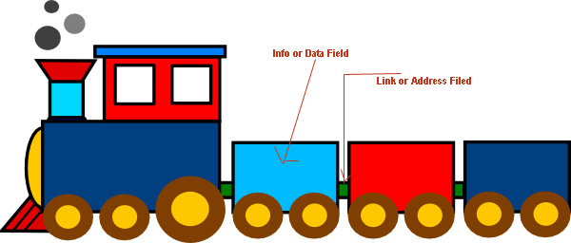
Linked List
A linked list is a linear data structure.
Nodes make up linked lists.
Nodes are structures made up of data and a pointer to another node.
Usually the pointer is called next.

Slide 19
Linked List
Introduction to Linked List
The elements of a linked list are not stored in adjacent memory locations as in arrays.
It is a linear collection of data elements, called nodes, where the linear order is implemented by means of pointers.

Slide 20
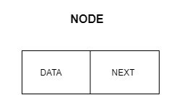
Linked List
Continued….
In a linear or single-linked list, a node is connected to the next node by a single link.
A node in this type of linked list contains two types of fields
data: which holds a list element
next: which stores a link (i.e. pointer) to the next node in the list.

Slide 21
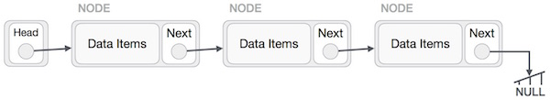
Linked List Representation
Linked list can be visualized as a chain of nodes, where every node points to the next node.
As per the above illustration, following are the important points to be considered.
Linked List contains a link element called first.
Each link carries a data field(s) and a link field called next.
Each link is linked with its next link using its next link.
Last link carries a link as null to mark the end of the list.

Slide 22
Properties of linked list
The nodes in a linked list are not stored contiguously in the memory
You don’t have to shift any element in the list
Memory for each node can be allocated dynamically whenever the need arises.
The size of a linked list can grow or shrink dynamically

Slide 23
Basic Operations on Linked List
Following are the basic operations supported by a list.
Insertion − Adds an element at the beginning of the list.
Deletion − Deletes an element at the beginning of the list.
Display − Displays the complete list.
Search − Searches an element using the given key.
Delete − Deletes an element using the given key.

Slide 24
Arrays & Linked list
Arrays | Linked list
Fixed size: Resizing is expensive | Dynamic size
Insertions and Deletions are inefficient: Elements are usually shifted | Insertions and Deletions are efficient: No shifting
Random access i.e., efficient indexing | No random access → Not suitable for operations requiring accessing elements by index such as sorting
No memory waste if the array is full or almost full; otherwise may result in much memory waste. | Since memory is allocated dynamically(acc. to our need) there is no waste of memory.
Sequential access is faster [Reason: Elements in contiguous memory locations] | Sequential access is slow [Reason: Elements not in contiguous memory locations]

Slide 25
Types of Link List
Following are the various types of linked list.
Singly Linked List − Item navigation is forward only.
Doubly Linked List − Items can be navigated forward and backward.
Circular Linked List − Last item contains link of the first element as next
Circular Doubly Linked List − Last item contains link of the first element as next and the first element has a link to the last element as previous. Items can be navigated forward and backward.

Slide 26
Singly Linked list
A singly linked list is a dynamic data structure which may grow or shrink, and growing and shrinking depends on the operation made.
In this type of linked list each node contains two fields one is data field which is used to store the data items and another is next field that is used to point the next node in the list.
data
next
data
next
data
next
5
3
8
null

Slide 27
Creating a node of linked list
# Node class (Creating a node of linked list)
class Node:
# Function to initialize the node object
def __init__(self, data):
self.data = data # Assign data
self.next = None # Initialize next as null
Node1=Node(25)
Node1
25 | None

Slide 28
Creating an empty linked list
# Node class (Creating a node of linked list)
class Node:
# Function to initialize the node object
def __init__(self, data):
self.data = data # Assign data
self.next = None # Initialize next as null
# Linked List class (Linking the nodes of linked list)
class LinkedList:
# Function to initialize the Linked List object
def __init__(self):
self.head = None

Slide 29
Creating a linked list with single node
class Node:
def __init__(self, data):
self.data = data
self.next = None
class LinkedList:
def __init__(self):
self.head = None
LL = LinkedList()
LL.head = Node(3)
print(LL.head.data)

Slide 30
Creation and Traversal of single linked list
# A single node of a singly linked list
class Node:
def __init__(self, data):
self.data = data
self.next = None
# A Linked List class with a single head node
class LinkedList:
def __init__(self):
self.head = None
# insertion method for the linked list
def insert(self, data):
newNode = Node(data)
if(self.head):
current = self.head
while(current.next):
current = current.next
current.next = newNode
else:
self.head = newNode

Slide 31
Creation and Traversal of single linked list
(contd..)
# print method for the linked list
def printLL(self):
current = self.head
while(current):
print(current.data)
current = current.next
# Singly Linked List with insertion and print methods
LL = LinkedList()
LL.insert(3)
LL.insert(4)
LL.insert(5)
LL.printLL()

Slide 32
Insertion in a Single Linked List
There are three possible positions where we can enter a new node in a linked list –
Insertion at beginning
Insertion at end
Insertion at given position
Adding a new node in linked list is a more than one step activity.

Slide 33
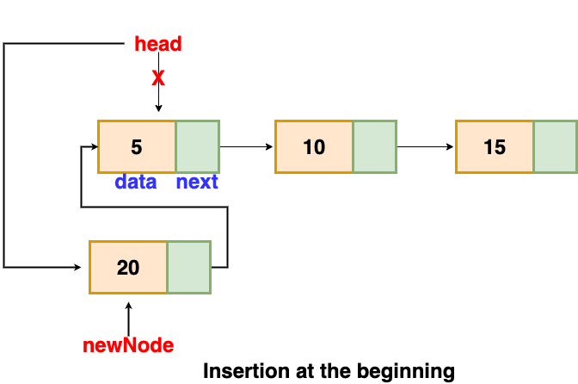
Insertion in a Single Linked List (at beginning)
Insertion at beginning

Slide 34
Insertion in single linked list (at beginning)
# A single node of a singly linked list
class Node:
def __init__(self, data):
self.data = data
self.next = None
# A Linked List class with a single head node
class LinkedList:
def __init__(self):
self.head = None
# insertion method for the linked list at beginning
def insert_beg(self, data):
newNode = Node(data)
if(self.head):
newNode.next=self.head
self.head=newNode
else:
self.head = newNode

Slide 35
Insertion in single linked list (at beginning)
(contd..)
# print method for the linked list
def printLL(self):
current = self.head
if(current!=None):
print("The List Contains:",end="\n")
while(current):
print(current.data)
current = current.next
else:
print("List is Empty.")
# Singly Linked List with insertion and print methods
LL = LinkedList()
LL.insert_beg(3)
LL.insert_beg(4)
LL.insert_beg(5)
LL.printLL()

Slide 36
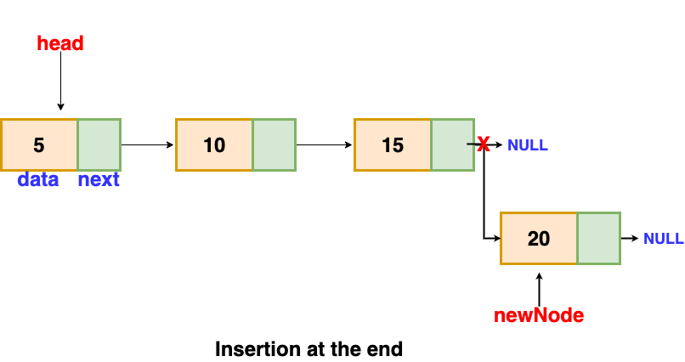
Insertion in a Single Linked List (at end)
Insertion at end
Temp

Slide 37
Insertion in single linked list (at end)
# A single node of a singly linked list
class Node:
def __init__(self, data):
self.data = data
self.next = None
# A Linked List class with a single head node
class LinkedList:
def __init__(self):
self.head = None
# insertion method for the linked list at end
def insert_end(self, data):
newNode = Node(data)
if(self.head):
current = self.head
while(current.next):
current = current.next
current.next = newNode
else:
self.head = newNode

Slide 38
Insertion in single linked list (at end)
(contd..)
# print method for the linked list
def printLL(self):
current = self.head
if(current!=None):
print("The List Contains:",end="\n")
while(current):
print(current.data)
current = current.next
else:
print("List is Empty.")
# Singly Linked List with insertion and print methods
LL = LinkedList()
LL.insert_end(3)
LL.insert_end(4)
LL.insert_end(5)
LL.printLL()

Slide 39
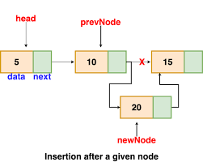
Insertion in a Single Linked List
(at given position)
Insertion at given position

Slide 40
Insertion in single linked list (at position)
# A single node of a singly linked list
class Node:
def __init__(self, data):
self.data = data
self.next = None
# A Linked List class with a single head node
class LinkedList:
def __init__(self):
self.head = None
# creation method for the linked list
def create(self, data):
newNode = Node(data)
if(self.head):
current = self.head
while(current.next):
current = current.next
current.next = newNode
else:
self.head = newNode

Slide 41
Insertion in single linked list (at position)
# insertion method for the linked list at given position
def insert_position(self, data, pos):
newNode = Node(data)
if(pos<1):
print("\nPosition should be >=1.")
elif(pos==1):
newNode.next=self.head
self.head=newNode
else:
current=self.head
for i in range(1, pos-1):
if(current!=None):
current=current.next
if(current!=None):
newNode.next=current.next
current.next=newNode
else:
print("\nThe previous node is null.")

Slide 42
Insertion in single linked list (at position)
# print method for the linked list
def printLL(self):
current = self.head
if(current!=None):
print("The List Contains:",end="\n")
while(current):
print(current.data)
current = current.next
else:
print("List is Empty.")
# Singly Linked List with insertion and print methods
LL = LinkedList()
LL.create(2)
LL.create(3)
LL.create(4)
LL.create(5)
LL.create(6)
LL.insert_position(9, 4)
LL.printLL()

Slide 43
Deletion in a Single Linked List
There are three possible positions where we can enter a new node in a linked list –
Deletion at beginning
Deletion at end
Deletion from given position
Deleting new node in linked list is a more than one step activity.

Slide 44
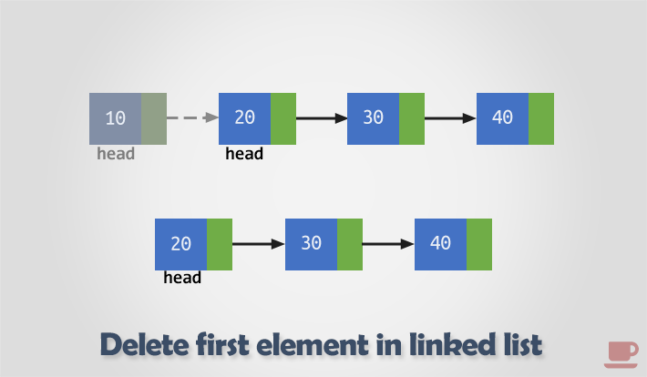
Deletion in Single Linked List (from beginning)
Deletion from beginning

Slide 45
Deletion in Single Linked List (from beginning)
# A single node of a singly linked list
class Node:
def __init__(self, data):
self.data = data
self.next = None
# A Linked List class with a single head node
class LinkedList:
def __init__(self):
self.head = None
# create method for the linked list
def create(self, data):
newNode = Node(data)
if(self.head):
current = self.head
while(current.next):
current = current.next
current.next = newNode
else:
self.head = newNode

Slide 46
Deletion in Single Linked List (from beginning)
#Delete first node of the list
def del_beg(self):
if(self.head == None):
print("Underflow-Link List is empty")
else:
temp = self.head
self.head = self.head.next
print("the deleted element is", temp.data)
temp = None
# print method for the linked list
def printLL(self):
current = self.head
if(current!=None):
print("The List Contains:",end="\n")
while(current):
print(current.data)
current = current.next
else:
print("List is Empty.")

Slide 47
Deletion in Single Linked List (from beginning)
# Singly Linked List with deletion and print methods
LL = LinkedList()
LL.create(3)
LL.create(4)
LL.create(5)
LL.printLL()
LL.del_beg()
LL.printLL()

Slide 48
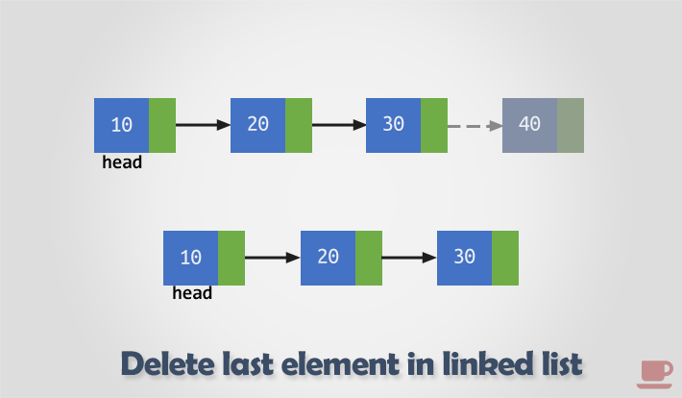
Deletion in Single Linked List (from end)
Deletion from end

Slide 49
Deletion in Single Linked List (from end)
# A single node of a singly linked list
class Node:
def __init__(self, data):
self.data = data
self.next = None
# A Linked List class with a single head node
class LinkedList:
def __init__(self):
self.head = None
# create method for the linked list
def create(self, data):
newNode = Node(data)
if(self.head):
current = self.head
while(current.next):
current = current.next
current.next = newNode
else:
self.head = newNode

Slide 50
Deletion in Single Linked List (from end)
#Delete last node of the list
def del_end(self):
if(self.head == None):
print("Underflow-Link List is empty")
else:
temp = self.head
while(temp.next!=None):
prev=temp
temp=temp.next
prev.next=None
print("The deleted element is", temp.data)
temp = None
# print method for the linked list
def printLL(self):
current = self.head
if(current!=None):
print("The List Contains:",end="\n")
while(current):
print(current.data)
current = current.next
else:
print("List is Empty.")

Slide 51
Deletion in Single Linked List (from end)
# Singly Linked List with deletion and print methods
LL = LinkedList()
LL.create(3)
LL.create(4)
LL.create(5)
LL.printLL()
LL.del_end()
LL.printLL()

Slide 52
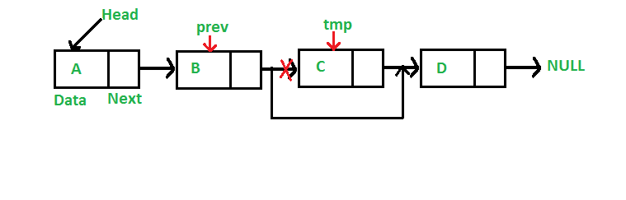
Deletion in Single Linked List (from position)
Deletion from position

Slide 53
Deletion in Single Linked List (from position)
# A single node of a singly linked list
class Node:
def __init__(self, data):
self.data = data
self.next = None
# A Linked List class with a single head node
class LinkedList:
def __init__(self):
self.head = None
# create method for the linked list
def create(self, data):
newNode = Node(data)
if(self.head):
current = self.head
while(current.next):
current = current.next
current.next = newNode
else:
self.head = newNode

Slide 54
Deletion in Single Linked List (from position)
# Deletion method from the linked list at given position
def del_position(self, pos):
if(pos<1):
print("\nPosition should be >=1.")
elif(pos==1):
temp = self.head
self.head = self.head.next
print("the deleted element is", temp.data)
temp = None
else:
temp=self.head
for i in range(1, pos):
if(temp!=None):
prev=temp
temp=temp.next
if(temp!=None):
prev.next=temp.next
print("the deleted element is", temp.data)
temp=None
else:
print("\nThe position does not exist in link list.")

Slide 55
Deletion in Single Linked List (from position)
# print method for the linked list
def printLL(self):
current = self.head
if(current!=None):
print("The List Contains:",end="\n")
while(current):
print(current.data)
current = current.next
else:
print("List is Empty.")
# Singly Linked List with deletion and print methods
LL = LinkedList()
LL.create(3)
LL.create(4)
LL.create(5)
LL.create(6)
LL.create(7)
LL.create(8)
LL.printLL()
LL.del_position(4)
LL.printLL()

Slide 56
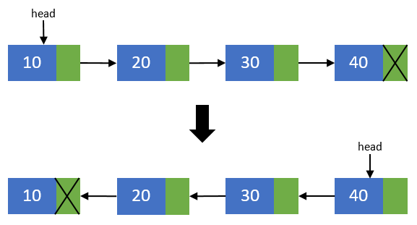
Reverse of a Single Linked List
If the linked list has two or more elements, we can use three pointers to implement an iterative solution..

Slide 57
Reverse of a Single Linked List
# Method to Reverse the linked list
def reverse(self):
if(self.head==None):
print("List is Empty.")
elif(self.head.next==None):
print("Only one node is present in list")
else:
temp1 = self.head
temp2=temp1.next
temp3=temp2.next
temp1.next=None
while(temp3!=None):
temp2.next=temp1
temp1=temp2
temp2=temp3
temp3=temp3.next
temp2.next=temp1
self.head=temp2

Slide 58
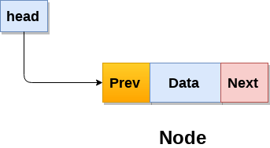
Doubly Linked List
Doubly linked list is a complex type of linked list in which a node contains a pointer to the previous as well as the next node in the sequence.
Therefore, in a doubly linked list, a node consists of three parts: node data, pointer to the next node in sequence (next pointer) , pointer to the previous node (previous pointer).
A sample node in a doubly linked list is shown in the figure.

Slide 59
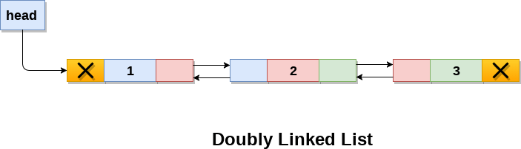
Doubly Linked List
A doubly linked list containing three nodes is shown in the following image.

Slide 60
Creating a Node of Doubly Linked List
Create a class for creating a node in a doubly linked list, with three attributes: the data, previous pointer and next pointer. The code looks like this:
class Node:
def __init__(self, data):
self.prev = None
self.item = data
self.next = None

Slide 61
Creating Doubly Linked List Class
Create a doublyLinkedList class, that contains different functions to insert, delete and display elements of doubly linked list.
class doublyLinkedList:
def __init__(self):
self.start_node = None

Slide 62
Creating a Doubly linked list with single node
class Node:
def __init__(self, data):
self,prev=None
self.data = data
self.next = None
class DoublyLinkedList:
def __init__(self):
self.head = None
LL = DoublyLinkedList()
LL.head = Node(3)
print(LL.head.data)

Slide 63
Creation and Traversal of Doubly linked list
# A single node of a doubly linked list
class Node:
def __init__(self, data):
self.prev = None
self.data = data
self.next = None
# A Linked List class with a single head node
class DoublyLinkedList:
def __init__(self):
self.head = None
# creation method for the doubly linked list
def create(self, data):
newNode = Node(data)
if(self.head==None):
self.head = newNode
else:
temp=self.head
while(temp.next!=None):
temp=temp.next
temp.next=newNode
newNode.prev=temp

Slide 64
Creation and Traversal of doubly linked list
(contd..)
# print method for the linked list
def printLL(self):
current = self.head
if(current!=None):
print("The List Contains:",end="\n")
while(current!=None):
print(current.data)
current = current.next
else:
print("List is Empty.")
# Singly Linked List with creation and print methods
LL = DoublyLinkedList()
LL.create(3)
LL.create(4)
LL.create(5)
LL.create(6)
LL.printLL()

Slide 65
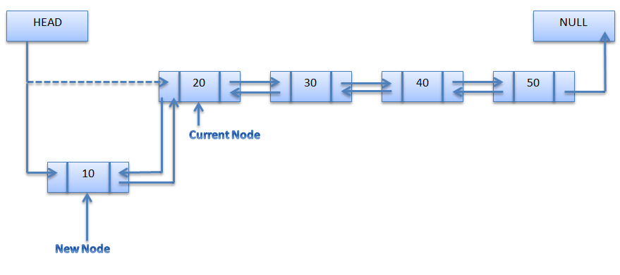
Insertion at the Beginning Linked List
Insertion at the Beginning of Doubly Linked List

Slide 66
Insertion at Beginning in Doubly linked list
# A single node of a doubly linked list
class Node:
def __init__(self, data):
self.prev = None
self.data = data
self.next = None
# A Linked List class with a single head node
class DoublyLinkedList:
def __init__(self):
self.head = None
# Insertion method for the doubly linked list at beginning
def insert_beg(self, data):
newNode = Node(data)
if(self.head==None):
self.head = newNode
else:
newNode.next=self.head
self.head.prev=newNode
self.head=newNode

Slide 67
Insertion at Beginning in Doubly linked list
(contd..)
# print method for the linked list
def printLL(self):
current = self.head
if(current!=None):
print("The List Contains:",end="\n")
while(current!=None):
print(current.data)
current = current.next
else:
print("List is Empty.")
# Singly Linked List with creation and print methods
LL = DoublyLinkedList()
LL.insert_beg(6)
LL.insert_beg(5)
LL.insert_beg(4)
LL.insert_beg(3)
LL.printLL()

Slide 68
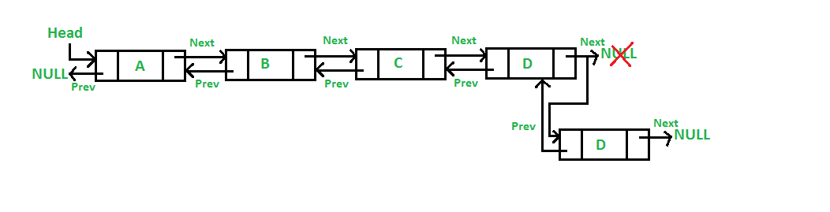
Insertion at the end of Doubly Linked List
Insertion at the end of Doubly Linked List

Slide 69
Insertion at end in Doubly linked list
# A single node of a doubly linked list
class Node:
def __init__(self, data):
self.prev = None
self.data = data
self.next = None
# A Linked List class with a single head node
class DoublyLinkedList:
def __init__(self):
self.head = None
# Insertion method for the doubly linked list at end
def insert_end(self, data):
newNode = Node(data)
if(self.head==None):
self.head = newNode
else:
temp=self.head
while(temp.next!=None):
temp=temp.next
temp.next=newNode
newNode.prev=temp

Slide 70
Insertion at end in Doubly linked list
(contd..)
# print method for the linked list
def printLL(self):
current = self.head
if(current!=None):
print("The List Contains:",end="\n")
while(current!=None):
print(current.data)
current = current.next
else:
print("List is Empty.")
# Singly Linked List with creation and print methods
LL = DoublyLinkedList()
LL.insert_end(3)
LL.insert_end(4)
LL.insert_end(5)
LL.insert_end(6)
LL.printLL()

Slide 71
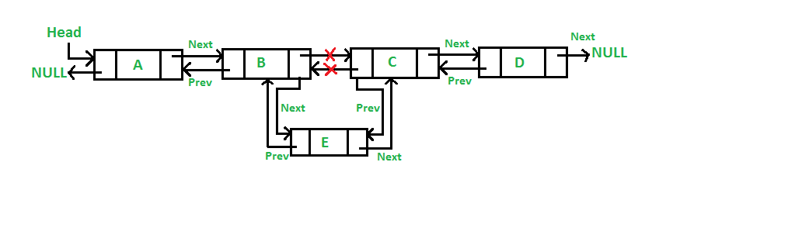
Insertion in Doubly Linked List (at position)
Insertion at given position in Doubly Linked List

Slide 72
Insertion in Doubly Linked List (at position)
# A single node of a doubly linked list
class Node:
def __init__(self, data):
self.prev = None
self.data = data
self.next = None
# A Linked List class with a single head node
class DoublyLinkedList:
def __init__(self):
self.head = None
# creation method for the doubly linked list
def create(self, data):
newNode = Node(data)
if(self.head==None):
self.head = newNode
else:
temp=self.head
while(temp.next!=None):
temp=temp.next
temp.next=newNode
newNode.prev=temp

Slide 73
Insertion in Doubly Linked List (at position)
(contd..)
# insertion method for the doubly linked list at given position
def insert_position(self, data, pos):
newNode = Node(data)
if(pos<1):
print("\nPosition should be >=1.")
elif(pos==1):
newNode.next=self.head
self.head=newNode
else:
current=self.head
for i in range(1, pos-1):
if(current!=None):
current=current.next
if(current!=None):
newNode.next=current.next
current.next.prev=newNode
current.next=newNode
newNode.prev=current
else:
print("\nThe previous node is null.")

Slide 74
Insertion in Doubly Linked List (at position)
(contd..)
# print method for the linked list
def printLL(self):
current = self.head
if(current!=None):
print("The List Contains:",end="\n")
while(current!=None):
print(current.data)
current = current.next
else:
print("List is Empty.")
# Singly Linked List with creation and print methods
LL = DoublyLinkedList()
LL.create(3)
LL.create(4)
LL.create(5)
LL.create(6)
LL.create(7)
LL.printLL()
LL.insert_position(4, 9)
LL.printLL()

Slide 75
Deletion in a Doubly Linked List
Similar to single linked list there are three possible positions where we can enter a new node in a doubly linked list –
Deletion at beginning
Deletion at end
Deletion from given position
Deleting new node in linked list is a more than one step activity.

Slide 76
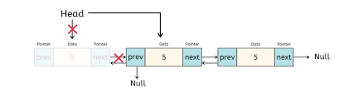
Deletion in Doubly Linked List (from beginning)
Deletion from beginning

Slide 77
Deletion in Doubly Linked List (from beginning)
# A single node of a doubly linked list
class Node:
def __init__(self, data):
self.prev = None
self.data = data
self.next = None
# A Linked List class with a single head node
class DoublyLinkedList:
def __init__(self):
self.head = None
# creation method for the doubly linked list
def create(self, data):
newNode = Node(data)
if(self.head==None):
self.head = newNode
else:
temp=self.head
while(temp.next!=None):
temp=temp.next
temp.next=newNode
newNode.prev=temp

Slide 78
Deletion in Doubly Linked List (from beginning)
(contd..)
#Delete first node of the list
def del_beg(self):
if(self.head == None):
print("Underflow-Link List is empty")
else:
temp = self.head
self.head = self.head.next
self.head.prev=None
print("the deleted element is", temp.data)
temp = None
# print method for the linked list
def printLL(self):
current = self.head
if(current!=None):
print("The List Contains:",end="\n")
while(current!=None):
print(current.data)
current = current.next
else:
print("List is Empty.")

Slide 79
Deletion in Doubly Linked List (from beginning)
(contd..)
# Doubly Linked List with creation, deletion and print methods
LL = DoublyLinkedList()
LL.create(3)
LL.create(4)
LL.create(5)
LL.create(6)
LL.printLL()
LL.del_beg()
LL.printLL()

Slide 80
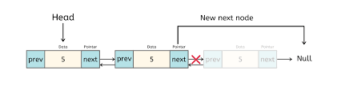
Deletion in Doubly Linked List (from end)
Deletion from end

Slide 81
Deletion in Doubly Linked List (from end)
# A single node of a doubly linked list
class Node:
def __init__(self, data):
self.prev = None
self.data = data
self.next = None
# A Linked List class with a single head node
class DoublyLinkedList:
def __init__(self):
self.head = None
# creation method for the doubly linked list
def create(self, data):
newNode = Node(data)
if(self.head==None):
self.head = newNode
else:
temp=self.head
while(temp.next!=None):
temp=temp.next
temp.next=newNode
newNode.prev=temp

Slide 82
Deletion in Doubly Linked List (from end)
(contd..)
#Delete last node of the list
def del_end(self):
if(self.head == None):
print("Underflow-Link List is empty")
else:
temp = self.head
while(temp.next!=None):
prev=temp
temp=temp.next
prev.next=None
print("The deleted element is", temp.data)
temp = None
# print method for the linked list
def printLL(self):
current = self.head
if(current!=None):
print("The List Contains:",end="\n")
while(current!=None):
print(current.data)
current = current.next
else:
print("List is Empty.")

Slide 83
Deletion in Doubly Linked List (from end)
(contd..)
# Doubly Linked List with creation, deletion and print methods
LL = DoublyLinkedList()
LL.create(3)
LL.create(4)
LL.create(5)
LL.create(6)
LL.printLL()
LL.del_end()
LL.printLL()

Slide 84
Deletion in Doubly Linked List (from position)
Deletion from end

Slide 85
Deletion in Doubly Linked List (from position)
# A single node of a doubly linked list
class Node:
def __init__(self, data):
self.prev = None
self.data = data
self.next = None
# A Linked List class with a single head node
class DoublyLinkedList:
def __init__(self):
self.head = None
# creation method for the doubly linked list
def create(self, data):
newNode = Node(data)
if(self.head==None):
self.head = newNode
else:
temp=self.head
while(temp.next!=None):
temp=temp.next
temp.next=newNode
newNode.prev=temp

Slide 86
Deletion in Doubly Linked List (from position)
(contd..)
# Deletion method from the linked list at given position
def del_position(self, pos):
if(pos<1):
print("\nPosition should be >=1.")
else:
temp=self.head
for i in range(1, pos):
if(temp!=None):
current=temp
temp=temp.next
if(temp!=None):
current.next=temp.next
temp.next.prev=current
print("the deleted element is", temp.data)
temp=None
else:
print("\nThe position does not exist in link list.")

Slide 87
Deletion in Doubly Linked List (from position)
(contd..)
# print method for the linked list
def printLL(self):
current = self.head
if(current!=None):
print("The List Contains:",end="\n")
while(current!=None):
print(current.data)
current = current.next
else:
print("List is Empty.")
# Doubly Linked List with creation, deletion and print methods
LL = DoublyLinkedList()
LL.create(3)
LL.create(4)
LL.create(5)
LL.create(6)
LL.create(7)
LL.create(8)
LL.printLL()
LL.del_position(4)
LL.printLL()

Slide 88
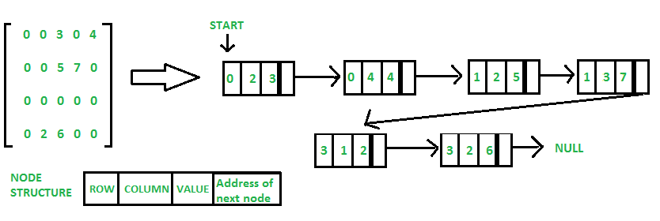
Linked Representation of Sparse Matrix
Introduction to Link List(CO1)
In linked list, each node has four fields. These four fields are defined as:
Row: Index of row, where non-zero element is located
Column: Index of column, where non-zero element is located
Value: Value of the non zero element located at index – (row , column)
Next node: Address of the next node

Slide 89
Polynomial Representation
Polynomials
Polynomials are the algebraic expressions which consist of exponents and coefficients.
Example -
10x² + 26x, here 10 and 26 are coefficients and 2, 1 is its exponential value.
Polynomial can be represented in the various ways. These are:
By the use of arrays
By the use of Linked List

Slide 90
Polynomial Representation
Polynomial can be represented
By the use of arrays
By the use of Linked List

Slide 91
Polynomial (Array Representation)
Array Representation:
p1(x) = 8x³ + 3x² + 2x + 6
p2(x) = 23x⁴ + 18x - 3
p1(x)
p2(x)
6 | 2 | 3 | 8
-3 | 18 | 0 | 0 | 23
0
2
0
2
4
Index represents exponents

Slide 92
Polynomial (Array Representation)
This is why arrays aren’t good to represent polynomials:
p3(x) = 16x²¹ - 3x⁵ + 2x + 6
6 | 2 | 0 | 0 | -3 | 0 | ………… | 0 | 16
WASTE OF SPACE!

Slide 93
Add Two Polynomials Using Arrays
Input: A[] = {5, 0, 10, 6} B[] = {1, 2, 4}
Output: sum[] = {6, 2, 14, 6}
The first input array represents "5 + 0x^1 + 10x^2 + 6x^3“
The second array represents "1 + 2x^1 + 4x^2"
And Output is "6 + 2x^1 + 14x^2 + 6x^3“

Slide 94
Polynomial (Array Representation)
Advantages of using an Array:
Only good for non-sparse polynomials.
Ease of storage and retrieval.
Disadvantages of using an Array:
Have to allocate array size priorly.
Huge array size required for sparse polynomials. Waste of space and runtime.

Slide 95
Polynomial Representation (using Linked List)
A polynomial p(x) is the expression in variable x which is in the form (ax^{n} + bx^{n-1} + …. + jx+ k), where a, b, c …., k fall in the category of real numbers and 'n' is non negative integer, which is called the degree of polynomial.
An essential characteristic of the polynomial is that each term in the polynomial expression consists of two parts:
one is the coefficient
other is the exponent
Example:
10x² + 26x,
here 10 and 26 are coefficients and 2, 1 is its exponential value.

Slide 96
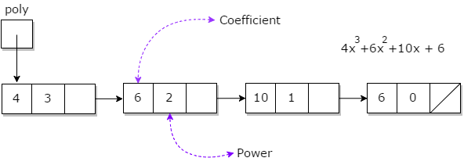
Polynomial Representation (using Linked List)
Points to keep in Mind while working with Polynomials:
The sign of each coefficient and exponent is stored within the coefficient and the exponent itself
Additional terms having equal exponent is possible one
The storage allocation for each term in the polynomial must be done in ascending and descending order of their exponent

Slide 97
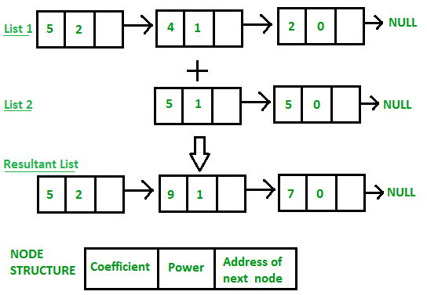
Polynomial Representation (using Linked List)
Addition of polynomial
1) Input: 1st number = 5x² + 4x¹ + 2x⁰
2nd number = -5x¹ - 5x⁰
Output: 5x²-1x¹-3x⁰
2) Input: 1st number = 5x³ + 4x² + 2x⁰
2nd number = 5x^1 - 5x^0
Output: 5x³ + 4x² + 5x¹ - 3x⁰

Slide 98
Polynomial Representation (using Linked List)
Subtraction of polynomial
Input: 1st number = 5x² + 4x¹ + 2x⁰
2nd number = -5x¹ - 5x⁰
Output: 5x² + 9x¹ + 7x⁰

Slide 99
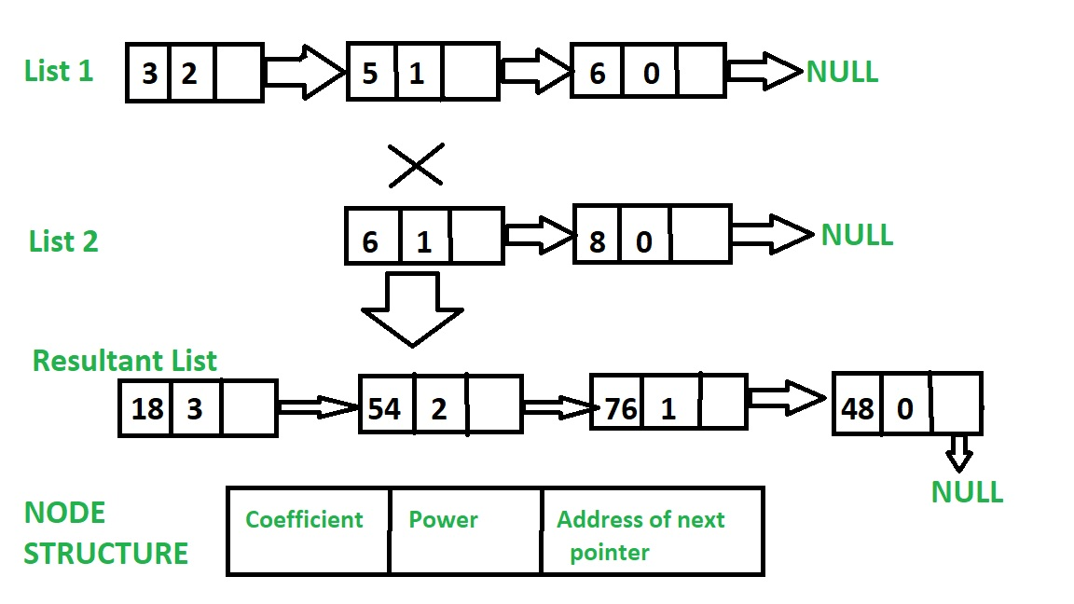
Polynomial Representation (using Linked List)
Multiplication of polynomial
Input: Poly1: 3x^2 + 5x^1 + 6, Poly2: 6x^1 + 8
Output: 18x^3 + 54x^2 + 76x^1 + 48

Slide 100
Stack Implementation using Linked List
Using List as Stack and Queues in Python (tutorialspoint.com)

Slide 101
Queue Implementation using Linked List
Using List as Stack and Queues in Python (tutorialspoint.com)

Slide 102
Daily Quiz
Which of the following is not a disadvantage to the usage of array?
a) Fixed size
b) There are chances of wastage of memory space if elements inserted in an array are lesser than the allocated size
c) Insertion based on position
d) Accessing elements at specified positions
What is the time complexity to count the number of elements in the linked list?
a) O(1)
b) O(n)
c) O(logn)
d) O(n2)

Slide 103
Daily Quiz
What is the space complexity for deleting a linked list?
a) O(1)
b) O(n)
c) Either O(1) or O(n)
d) O(logn)
What differentiates a circular linked list from a normal linked list?
a) You cannot have the ‘next’ pointer point to null in a circular linked list
b) It is faster to traverse the circular linked list
c) You may or may not have the ‘next’ pointer point to null in a circular linked list
d) Head node is known in circular linked list

Slide 104
Weekly Assignment
Define data structure and explain types of data structure with suitable examples
What are the primitive operations in any data structure
Explain the asymptotic notations with suitable examples
Differentiate between space and time complexity of an algorithm
Write an algorithm for merging two already sorted arrays
Write an algorithm/program for insert a node at between any position of a linked list
Write an algorithm/program to reverse a linked list
Write an algorithm/program to sort two linked lists
Write an algorithm/program to add two polynomials by using linked list
what are the applications of a single linked list, doubly linked list and circular linked list

Slide 105
MCQ s
Which of these best describes an array? a) A data structure that shows a hierarchical behaviour b) Container of objects of similar types c) Arrays are immutable once initialised d) Array is not a data structure
How do you initialize an array in C? a) int arr[3] = (1,2,3); b) int arr(3) = {1,2,3}; c) int arr[3] = {1,2,3}; d) int arr(3) = (1,2,3);

Slide 106
MCQ s
In the worst case, the number of comparisons needed to search a singly linked list of length n for a given element is (GATE CS 2002)
A log 2 n
B n/2
C log 2 n – 1
D n
You are given pointers to first and last nodes of a singly linked list, which of the following operations are dependent on the length of the linked list?
A Delete the first element
B Insert a new element as a first element
C Delete the last element of the list
D Add a new element at the end of the list

Slide 107
MCQ s
What are the advantages of arrays? a) Objects of mixed data types can be stored b) Elements in an array cannot be sorted c) Index of first element of an array is 1 d) Easier to store elements of same data type
Elements in an array are accessed _____________ a) randomly b) sequentially c) exponentially d) logarithmically

Slide 108
MCQ s
In linked list each node contain minimum of two fields. One field is data field to store the data second field is? A. Pointer to character B. Pointer to integer C. Pointer to node D. Node
Linked list data structure offers considerable saving in
A. Computational Time B. Space Utilization C. Space Utilization and Computational Time D. None of the mentioned

Slide 109
Glossary Question
i. Linked list ii. Abstract Data type iii.Asymptotic Analysis iv. Linear order
Answer the questions.
a. Another term for total order.
b. A process followed to solve a problem.
c. The specification of a data type with some language.
d. Dynamic allocation of link nodes to store the list of elements.

Slide 110
Old Question Papers
http://www.aktuonline.com/papers/btech-cs-3-sem-data-structures-kcs301-2020.html
http://www.aktuonline.com/papers/btech-cs-3-sem-data-structures-rcs-305-2018-19.html
http://www.aktuonline.com/papers/btech-cs-3-sem-data-structures-rcs-305-2017-18.html
http://www.aktuonline.com/papers/btech-cs-3-sem-data-structures-using-c-ncs-301-2016-17.html
https://www.aktuonline.com/papers/btech-cs-3-sem-data-structures-kcs301-2020.html
https://firstranker.com/fr/frdA290120A1345373/download-aktu-b-tech-3rd-sem-2018-2019-data-structures-rcs-305-question-paper

Slide 111
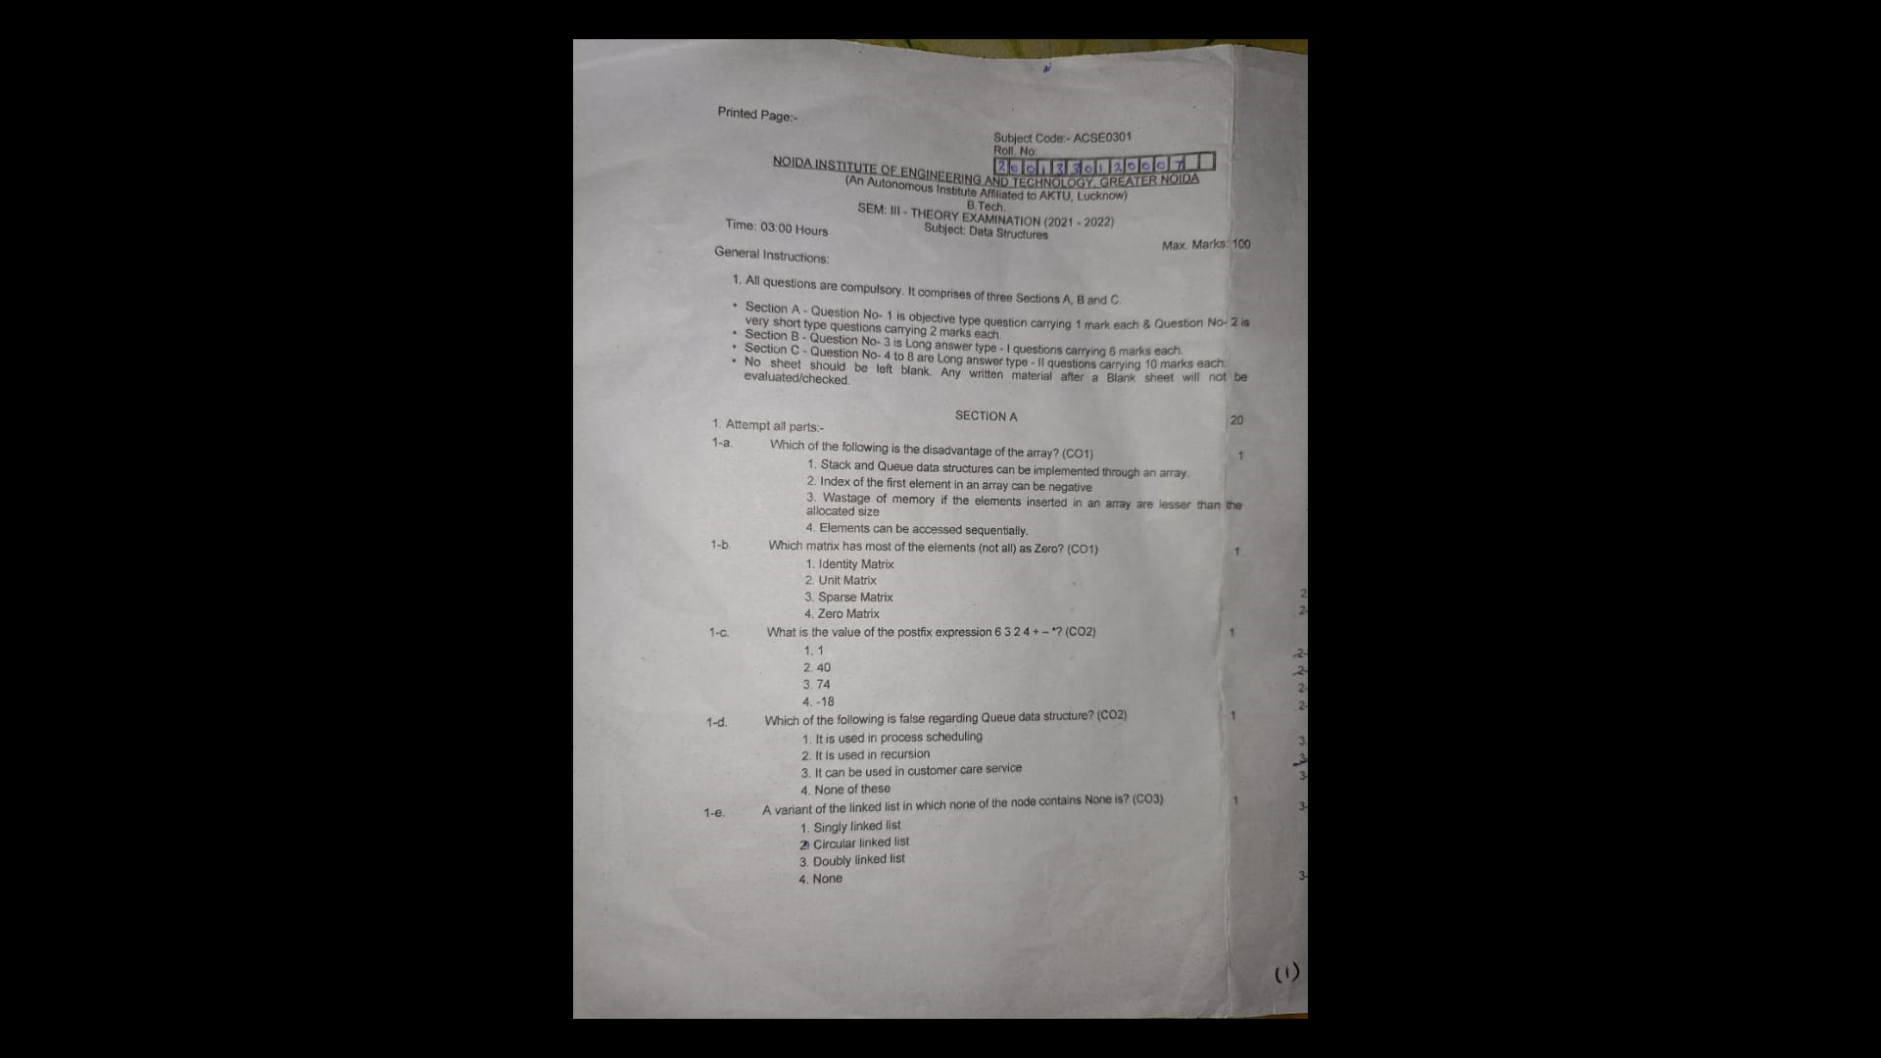
Old Question Papers

Slide 112
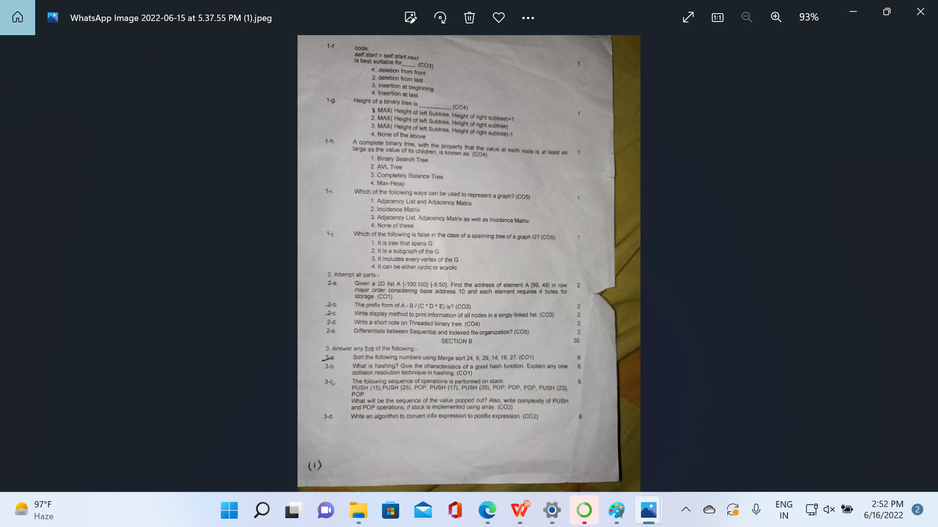
Old Question Papers

Slide 113
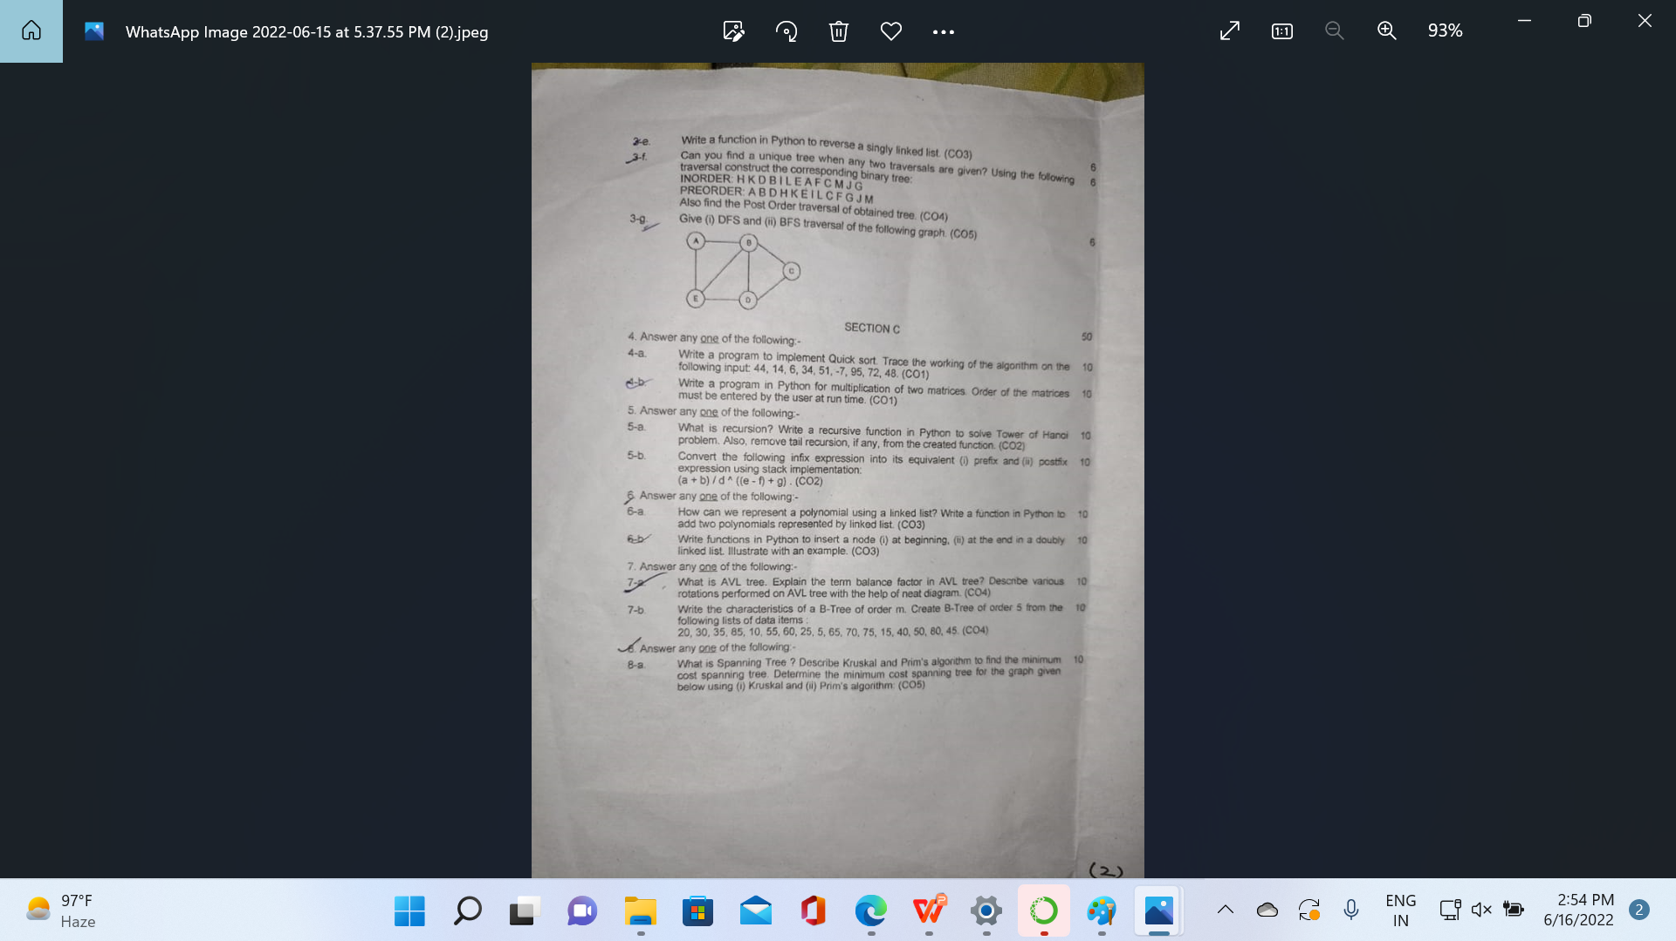
Old Question Papers

Slide 114
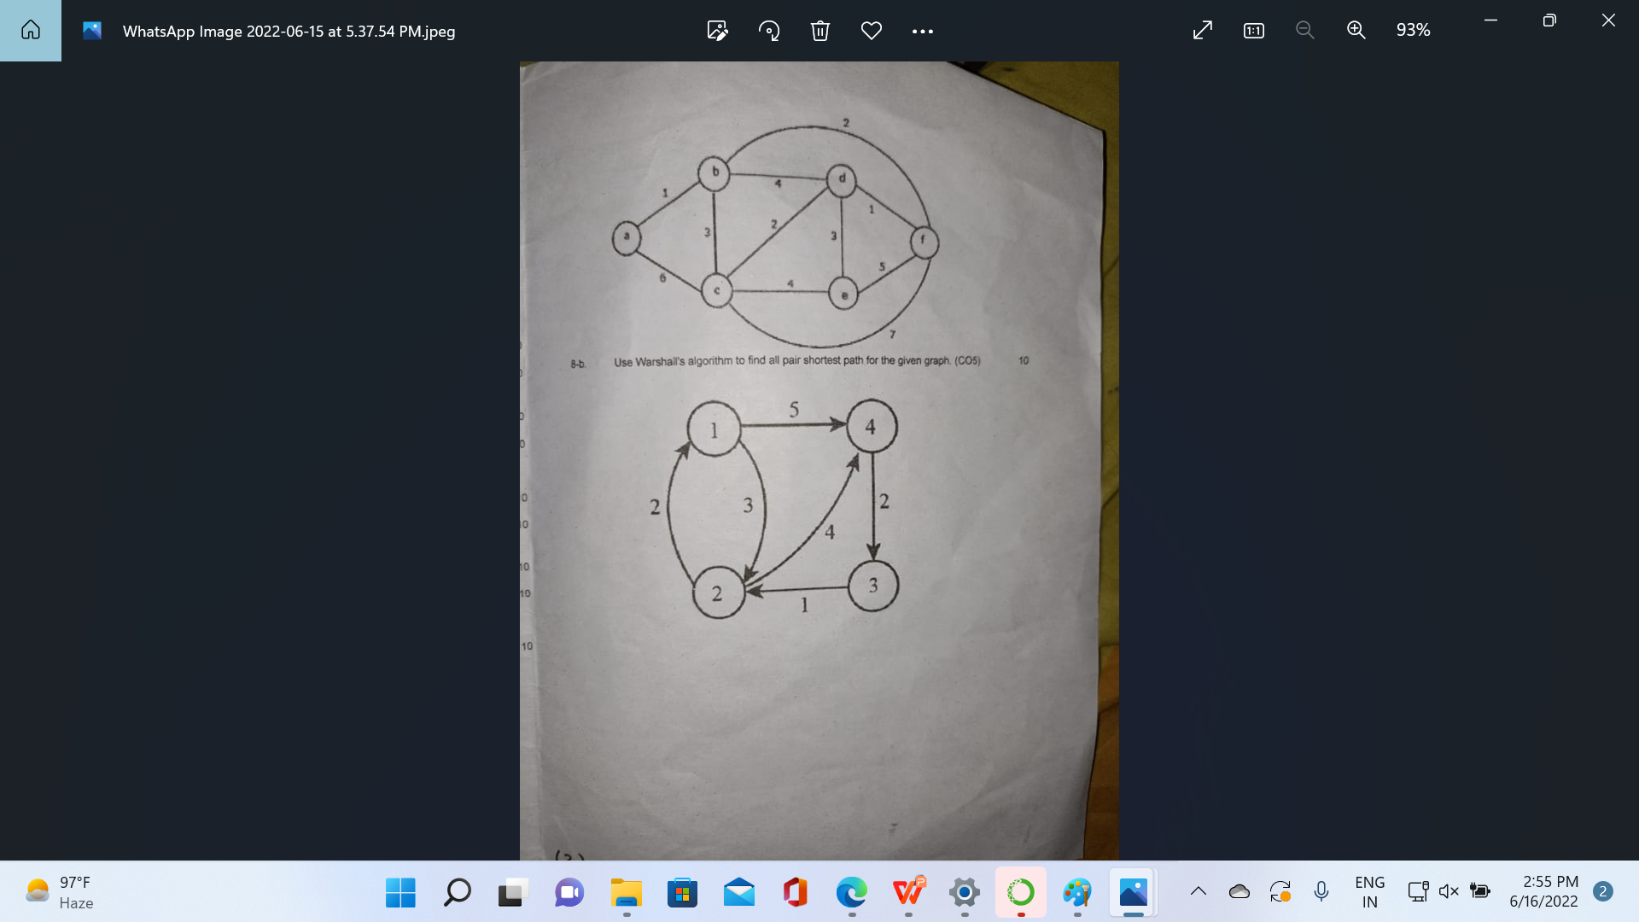
Old Question Papers

Slide 115
Expected Questions for University Exam
What is doubly linked list? What are its applications? Explain how an element can be deleted from doubly linked list using C program.
What are the merits and demerits of array? Given two arrays of integers in ascending order, develop an algorithm to merge these arrays to form a third array sorted in ascending order.
How can you represent a sparse matrix in memory?
List the various operations on linked list.
What do you understand by time and space trade off?
Define the various asymptotic notations. Derive the O-notation for linear search.
Write a program in c to delete a specific element in single linked list. Double linked list takes more space than single linked list for storing one extra address. Under what condition, could a double linked list more beneficial than single linked list.

Slide 116
Summary
We consider two fundamental data types for storing collections of objects: the stack and the queue.
We implement each using either a singly-linked list or a resizing array.
We introduce two advanced Java features—generics and iterators—that simplify client code.
Finally, we consider various applications of stacks and queues ranging from parsing arithmetic expressions to simulating queueing systems.

Slide 117
References
Aaron M. Tenenbaum, Yedidyah Langsam and Moshe J. Augenstein, “Data Structures Using C and C++”, PHI Learning Private Limited, Delhi India
Horowitz and Sahani, “Fundamentals of Data Structures”, Galgotia Publications Pvt Ltd Delhi India.
Lipschutz, “Data Structures” Schaum’s Outline Series, Tata McGraw-hill Education (India) Pvt. Ltd.
Thareja, “Data Structure Using C” Oxford Higher Education.
AK Sharma, “Data Structure Using C”, Pearson Education India.
Michael T. Goodrich, Roberto Tamassia, David M. Mount “Data Structures and Algorithms in C++”, Wiley India.
. P. S. Deshpandey, “C and Data structure”, Wiley Dreamtech Publication.

Slide 118
Thank You

